Slide 1

EXPERIMENTAL PRE-COLLEGE MATHEMATICS:
THEORY, PEDAGOGY, TOOLS
SERGEI ABRAMOVICH
STATE UNIVERSITY OF NEW YORK AT POTSDAM, USA

Slide 2
WHAT IS THE MODERN DAY MATHEMATICAL EXPERIMENT?
THE USE OF COMPUTING TECHNOLOGIES IN SUPPORT OF (PRE-COLLEGE) MATHEMATICS CURRICULUM

Slide 3
MATHEMATICAL EXPERIMENT IS LEARNERS’ INQUIRY INTO MATHEMATICAL STRUCTURES REPRESENTED BY
INTERACTIVE GRAPHS [e.g., the Graphing Calculator (Pacific Tech)]
DYNAMIC GEOMETRIC SHAPES
(GeoGebra, The Geometer’s Sketchpad)
ELECTRONICALLY GENERATED AND CONTROLLED ARRAYS OF NUMBERS
(computer spreadsheet)

Slide 4

Learning is the goal of a mathematical experiment

Slide 5







CURRENT EMPHASIS ON THE USE OF TECHNOLOGY IN THE TEACHING OF MATHEMATICS (LITERATURE AVAILABLE IN ENGLISH)
AUSTRALIA
CANADA
ENGLAND
JAPAN
SERBIA
SINGAPORE
US

Slide 6
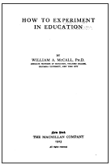
McCall (1923) – in a seminal book “How to experiment in education” –
Experiment is a milieu where “teachers join their pupils in becoming question askers”.
Teachers of mathematics need to have
experience in asking questions
Mathematical experiment motivates asking “Why” and
“What if” questions
“..activities are much more effective than conversations in provoking questions” (Forum of Education, 1928)

Slide 7
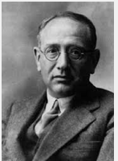
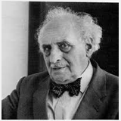
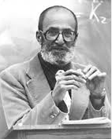
Learning to ask questions through analyzing experimental results
Pólya (1963): “For efficient learning,
an exploratory phase should precede
the phase of verbalization and concept formation.”
Freudenthal (1973): “[P]eople never experience
mathematics as an activity of solving problems,
except according to fixed rules.”
Halmos (1975): “The best way to teach teachers
is to make them ask and do what they, in turn,
will make their students ask and do.”

Slide 8
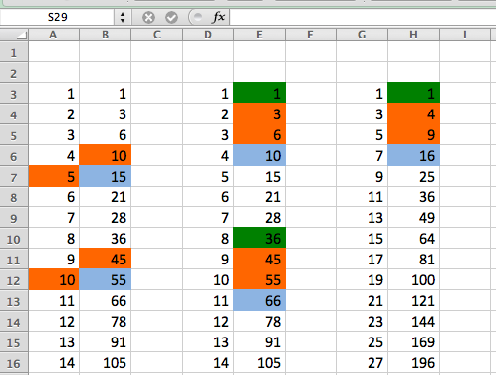
Teacher-motivated experiment
Asking ” Why” and “What if” questions.
We write what we see!
15 = 10 + 5
55= 45 + 10
10 = (6 – 3)3 +1
66 = (55 – 45)3 + 36

Slide 9
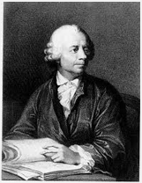
Observation: the bedrock of a mathematical experiment
Euler (in Commentationes Arithmeticae):
“the properties of numbers known today
have been mostly discovered by observation, and discovered long before their truth has been confirmed by rigid demonstration”.

Slide 10
Euler (continued)
“we should take great care not to accept as true such properties of the numbers which we have discovered by observations and … should use such a discovery as an opportunity to investigate more exactly the properties discovered and prove or disprove them”

Slide 11
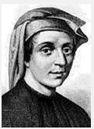
Bridging the gap between the past and the present

Slide 12

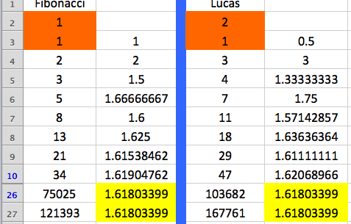
Experimental evidence using a computer spreadsheet

Slide 13
From experiment to theory
What is the exact value of 1.61803...?

Slide 14
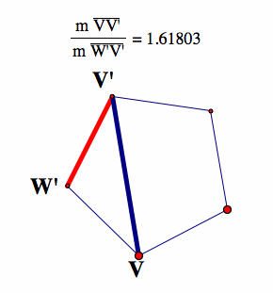
From experiment to theory
What are other contexts for the number1.61803...?
Using The Geometer’s Sketchpad
Formal demonstration of the Golden Ratio

Slide 15
Interplay between experiment and theory: An example

Slide 16
Interplay between experiment and theory: A concept map

Slide 17

Structures and descriptors of signature pedagogy (Shulman, 2005)
Surface structure
Deep Structure
Implicit structure
Uncertainty
Engagement
Formation

Slide 18
Mathematical experiment as signature pedagogy
Knowing main ideas and concepts of mathematics
Appreciating connections among concepts (the main goal of experimentation)
Having a toolkit of motivational techniques (computer experimentation)

Slide 19
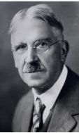
Collateral learning
(John Dewey, 1938)
“Perhaps the greatest of all pedagogical fallacies is the notion that a person learns only the particular thing he is studying at the time”
Elements of collateral learning:
Unintentional discovery
Hidden mathematics curriculum
The design of a mathematical experiment and its signature pedagogy provide ample opportunities for collateral learning .

Slide 20

Two types of technology application: Type I & Type 2
(Maddux, 1984)
Type I – surface structure of
signature pedagogy
Type II – requires acting at the deep structure of signature pedagogy dealing with uncertainty, motivating engagement, and enabling formation

Slide 21
Two styles of assistance in the digital era: Style I & Style 2
Style I – assistance at the surface structure
Style II – assistance at the deep structure to deal with uncertainty, support engagement, and enable formation
(working in the zone of proximal development)

Slide 22
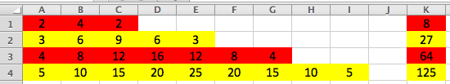
Style II assistance in the zone of proximal development: An example

Slide 23
Technology enabled mathematics pedagogy (TEMP)
Difference between MP and TEMP: MP lacks empirical
support for conjectures
TEMP has great potential to engage a much broader
student population in mathematical explorations
Four parts of a TEMP-based project:
Empirical
Speculative
Formal
Reflective

Slide 24
From teacher-motivated experiment to TEMP
Empirical
Speculative
Formal
Reflective

Slide 25
TEMP may lead to a mathematical frontier: An example

Slide 26
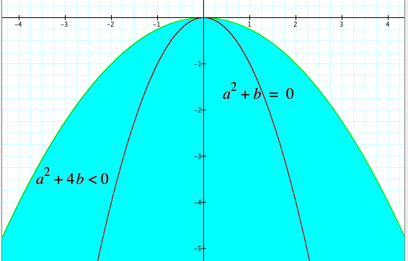
Cycles are due to a negative discriminant in the characteristic equation

Slide 27
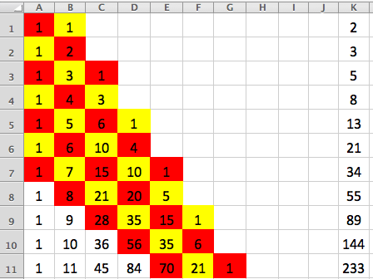
From Pascal’s triangle to an open problem:
Fibonacci-like polynomials don’t have complex roots

Slide 28
Conclusion
TEMP enables:
Experimental mathematics supported by computing
Move from experiment to proving
Collateral learning in the technological paradigm
Unintentional discovery
Entering hidden mathematics curriculum
Opening window to a mathematical frontier
Development of skills for STEM disciplines

Slide 29
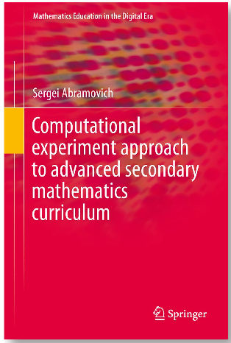

Slide 30
THANK YOU
abramovs@potsdam.edu
http://www2.potsdam.edu

